Slide 1
Team Name
Simple Senary
Team Members
Shubham Bhola(team leader)
Devansh Khandelwal
Rohit Sharma
Krati Jain
Pushkin Sharma
Kartikey Mishra
Institute Name
Netaji Subhash University of Technology
Institute Code (AISHE)
U-1056

Slide 2
PS Code
Problem Statement
Hosting a blockchain code on to a cloud network in order to create a prototype app in the Healthcare sector. – The team has built the code and UI/UX designs for the application, but we need help to host the program on a network and create a prototype. Therefore we need young professionals to help solve the hosting issue and build the prototype.
SJ572
Organization
White Hour Solutions
Category
Software

Slide 3
Solution
White Hour Solutions (WHS) LLP., is a young start-up looking to provide a solution for patient to record, store and share their Personal Health Records (PHRs).We plan to do this by providing an application which can be used through mobile phones, computers or tablets.
The idea is to store the data of patients, doctors and other staff on a blockchain so that a large amount of data can be stored very efficiently and securely. Through this we can also establish a proper chain of custody in drug shipments also.
We can even implement a patient-centric electronic health record for better user experience.

Slide 4
Use Cases
Blockchain and Healthcare to Enhance the Security and Control of Healthcare Transactions.
Blockchain to Establish Proper Chain of Custody in Drug Shipments.
Patient-centric electronic health records.
Medical Staff credential verification.

Slide 5
Market Size
The global healthcare blockchain market is projected to reach USD 829.0 million by 2023 from USD 53.9 million in 2018, at a CAGR of 72.8%. The increasing incidence of healthcare data breaches, increasing threat of counterfeit drugs, increasing adoption of blockchain as a service (BaaS), and transparency & immutability of the distributed ledger technology are the significant factors driving the growth of the market. However, the reluctance to disclose data and lack of a central entity & common set of standards are expected to restrain the growth of this market to a certain extent.

Slide 6
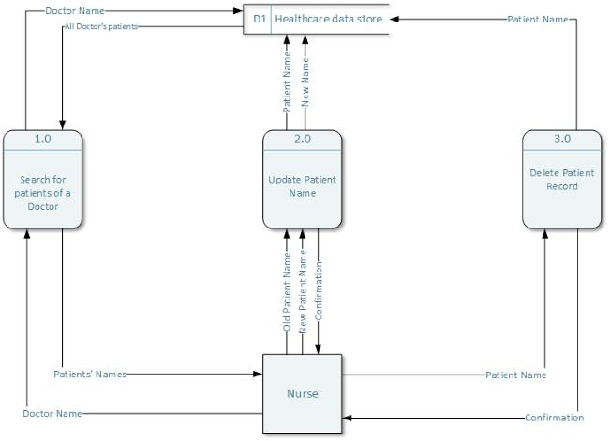
Product
Our team is building a blockchain application to store and share patient records with Doctors and Health care intermediaries.
The application will store the data of patients, doctors and other staff from the health care sector on a blockchain so that a large amount of data can be stored very efficiently and securely.
Through this we can also establish a proper chain of custody in drug shipments also.
We can even implement a patient-centric electronic health record for better user experience.

Slide 7
Business Model
We will generate revenue by selling services of our application to a customer.
The price of the service constitutes the production costs and margin. Increasing the margin, the business is able to generate more income from sales.
The service that will be provided can be either subscription type or one type purchase.

Slide 8
Competition
Akiri
BurstIQ
Factom
MedicalChain
ProCredEx
Avaneer
SimplyVital Health
RoboMed
Embleema
Chronicled

Slide 9
Financial model and projections
Investment to develop- This will include the cost for hosting the product along with its maintenance cost.
Return on Investment- Revenue will be generated by selling services of our application to the customers as subscription or one time pay.

Slide 10
Dependencies/ Show stoppers
Regulations have always struggled to keep up with advances in technology.
Decentralized networks can be much less resilient to shocks, which can impact participants directly, unless careful thought is given to their design.
It places trust and authority in a decentralized network rather than in a powerful central institution. And for most, this loss of control can be deeply unsettling.

